Slide 1
Flutter API
M Januar Alfiansyah 212410102003
Stefani Felisia Irawan 212410102012
M Amanda Maulan M 212410102035
(AI)

Slide 2
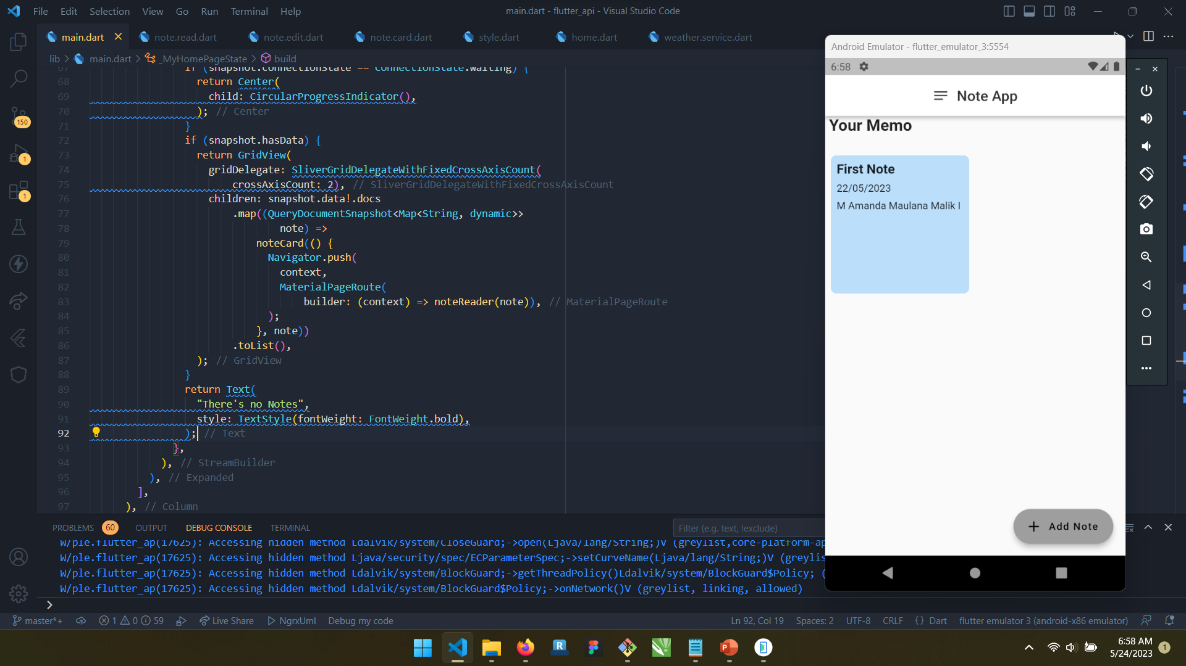
HomePage with Request

Slide 3
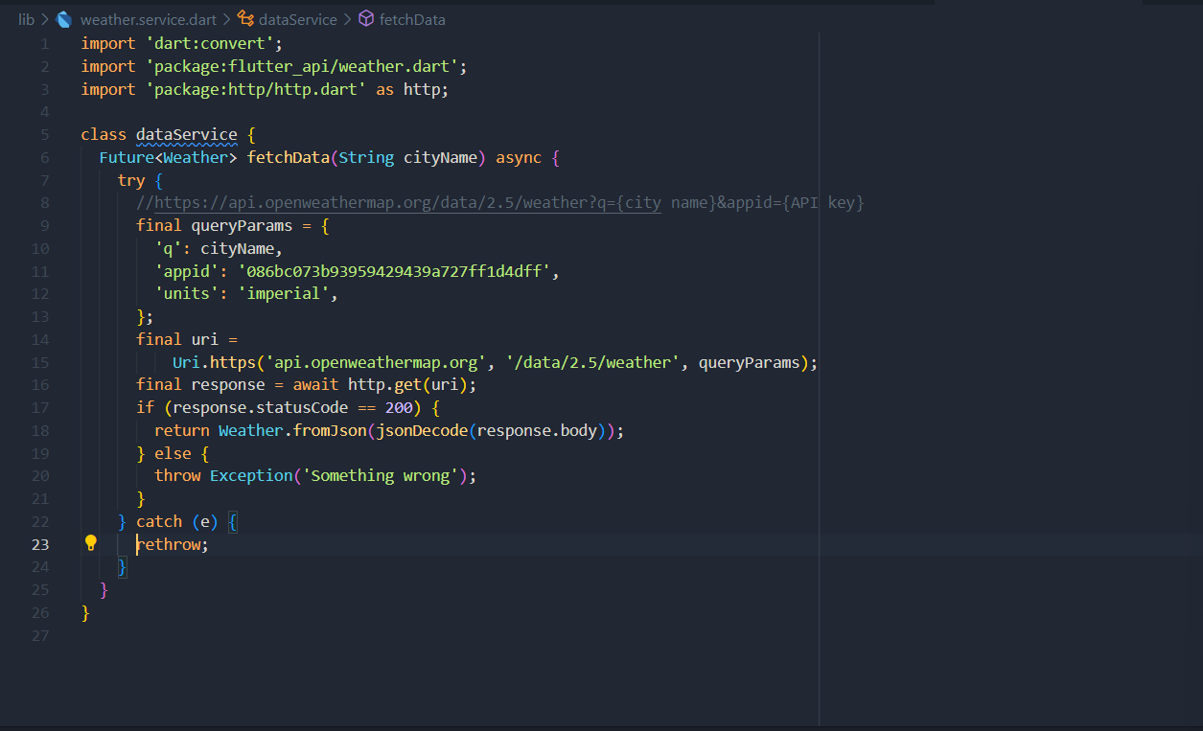
Future Widget

Slide 4
Other Free API

Slide 5
Thanks!

